Slide 1
GSM

Slide 2
Global System for Mobile Communication (GSM)
First introduced in 1991 in Europe
Radiolinja Oy was the first commercial company to offer services to the user in Finland in 1992.
In 1992, GSM got its new name from the previous French name Groupe Special Mobile !

Slide 3
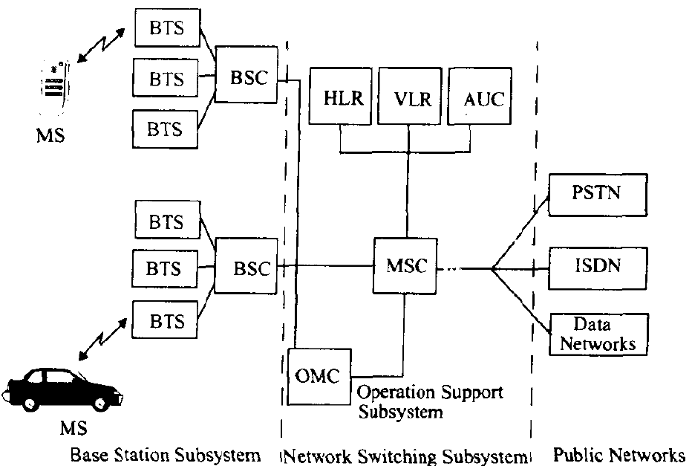
GSM Architecture
Three basic subsystems – BSS, NSS, OSS
BS=Base Station
BTS=Base Transceiver Station
BSC=Base Station Controller
MSC=Mobile Switching Center
HLR=Home Location Register
VLR=Visitor Location Register
AUC=Authentication Center
OMC=Operation Maintenance center
PSTN=Public Switched Telephone Network
ISDN=Integrated Services Digital Network

Slide 4
BSS
BSS manages the radio interface between the mobile station and the other subsystem. It consists of radio transmitters, receivers and the antenna system required to provide the coverage area for one cell.
Each BSS consists of many BSCs and each BSC in turn can control hundreds of BTSs.
Records and passes the Signal strength measurements to the BSC

Slide 5
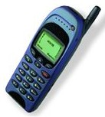

MS
The Mobile Equipment is said to be a Mobile Station if the Subscriber Identity Module ( SIM Card ) is added to it.
MS = ME + SIM
The SIM card contains a processor and memory that stores
  International Subscriber Identity Module (IMSI)
  The Authentication and ciphering keys
  Message and phone numbers
+
+

Slide 6
BSC
Manages the Radio Communication with the mobile station over the air interface
Controls the handover of calls in progress Between BTSs
Supervises the transmission network and the operation of each BTS

Slide 7
NSS
NSS manages the switching functions of the system and allows the MSCs to communicate with other networks like PSTN, ISDN
MSC is the central unit of NSS and controls the traffic among all the BSCs
NSS has three major databases
  HLR
  VLR
  AUC

Slide 8
MSC
Supervises Base Station Controller(s) BSC(s).
Switches calls to/from mobile subscribers.
Records charging and accounting details
Provides the gateway functionality to other networks.

Slide 9
HLR
The HLR is a centralized network database that stores and
manages all mobile subscriptions belonging to a specific operator.
It acts as a permanent store for a person's subscription
information until that subscription is canceled. The information
stored includes:
  Subscriber identity
  Subscriber supplementary services
  Subscriber location information
  Subscriber authentication information

Slide 10
VLR
The VLR temporarily stores subscription information so that the MSC can service all the subscribers currently visiting that MSC service area.
When a subscriber roams into a new MSC service area, the VLR connected to that MSC requests information about the subscriber from the subscriber's HLR.
The HLR sends a copy of the information to the VLR and updates its own location information. When the subscriber makes a call, the VLR will already have the information required for call set-up.

Slide 11
AUC
The main function of AUC is to authenticate the subscribers attempting to use the network. In this way, it is used to protect network operators against fraud.
The AUC is a database connected to the HLR which provides it with the authentication parameters and ciphering keys used to ensure network security.

Slide 12
OSS
OSS supports the operation and maintenance of the system and allows the system engineers to monitor, diagnose and troubleshoot all aspects of GSM systems
It maintains the performance of MS, BTS, BSC and MSC. It has three main functions:
  Maintain all network operation
  Manage the charging and billing procedures
  Manage all mobile stations in the system

Slide 13
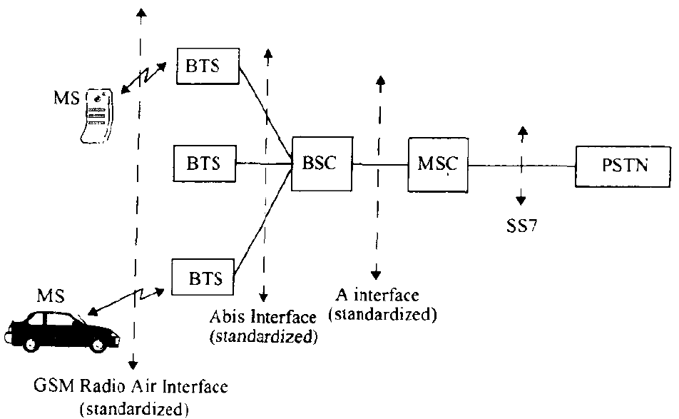
Interfaces used in GSM

Slide 14

Spectrum Allocation (GSM 900)
Downlink 935 – 960 MHz
Uplink 890 – 915 MHz
200 KHz
890.2
890.6
Uplink
1
1
2
3
4
121
121
122
123
124
890
890.4
915
F (MHz)
935.2
935.6
Downlink
1
121
1
2
3
4
121
122
123
124
935
935.4
960
F (MHz)
GSM 900 Frequency Allocation
ARFCN
Absolute Radio Frequency Channel Number

Slide 15
Spectrum Allocation (GSM 1800)
Downlink 1805 – 1880 MHz
Uplink 1710 – 1785 MHz
200 KHz
1710.2
1710.6
Uplink
1
2
3
4
371
372
373
374
1710
1710.4
1785
F (MHz)
1805.2
1805.6
Downlink
1
2
3
4
371
372
373
374
1805
1805.4
1880
F (MHz)
GSM 1800 Frequency Allocation

Slide 16
Comparison
1710
Uplink
1785
890
Uplink
915
95 MHz
45 MHz
GSM 1800
With 374 ARFCN
GSM 900
With 124 ARFCN
935
Downlink
960
25 MHz
1805
Downlink
1880
75 MHz

Slide 17
Reference
Wireless Communication Principles and Practice
  Theodore S. Rappaport

